Slide 1
Learning Objective
I will be able to determine the rule for graphs of exponential
Success Criteria
At the end of the lesson, I will be able to:
Determine the rule for graphs of exponential functions

Slide 2
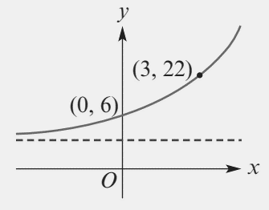

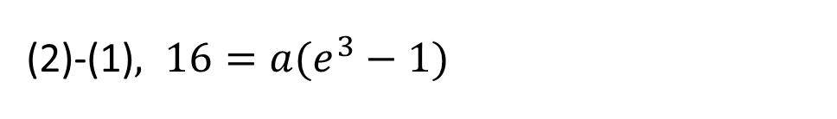


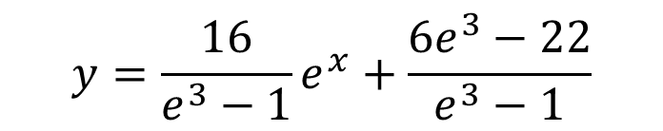
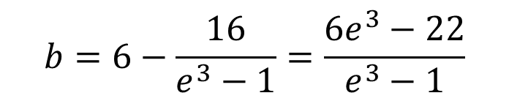
Guided Practice
The rule for the function with the graph shown is of the form $y=ae^{x}+b$. Determine the value of $a$ and $b,$ leaving your answers in exact form
Subst $\left(0,6\right), 6=ae^{0}+b⇒6=a+b −−(1)$
Subst $\left(3,22\right), 22=ae^{3}+b −−(2)$
(2)-(1)$, 16=a(e^{3}−1)$
$$a=\frac{16}{e^{3}−1}$$
$$b=6−\frac{16}{e^{3}−1}=\frac{6e^{3}−22}{e^{3}−1}$$
$$y=\frac{16}{e^{3}−1}e^{x}+\frac{6e^{3}−22}{e^{3}−1}$$

Slide 3
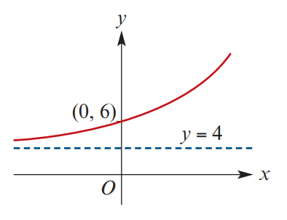



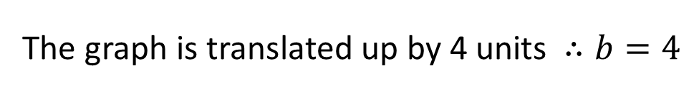
Guided Practice
The rule for the function with the graph shown is of the form $y=ae^{x}+b$. Determine the value of $a$ and $b,$ leaving your answers in exact form
Subst $\left(0,6\right), 6=ae^{0}+b⇒6=a+b −−(1)$
The graph is translated up by 4 units $∴b=4$
$$6=a+4$$
$$a=2$$
$$y=2e^{x}+4$$

Slide 4
Independent Practice
Cambridge Ex 2F Q1, 3, 4, 6

